Slide 1
How to create any chart in MICROSOFT EXCEL
MADE AND PRESENTED BY AMIN nEPALI

Slide 2
Hello everyone. In this video, I will explain how to create a chart in Microsoft Excel. Charts help us understand data easily using visuals.

Slide 3
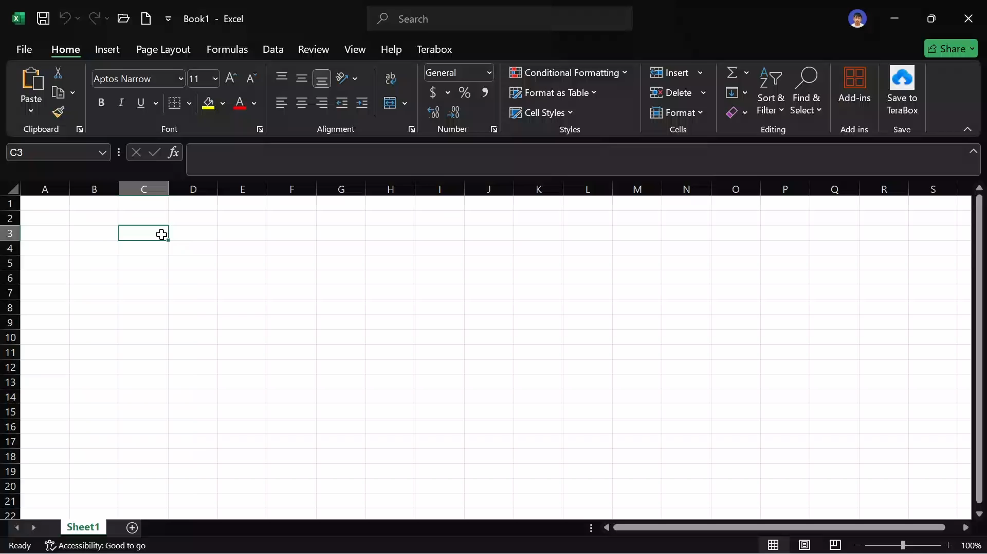
Lets follow the steps:
First, lets input some data to make chart
Secondly, select the data
Then, goto insert tab
Then, choose the charts directly or , click on small button on bottom right corner on chart section
Click on any chart you prefer and then click
Finally, goto save option from file tab, and then give a filename and then hit enter.

Slide 4
And finally we’ve made a chart in Microsoft excel.
If any question arise, feel free to contact me.

